Slide 1


Rock paper and scissor (using python)
Presented by-
Kashvi Jain 102153038 Yashika Gupta 102103828
Tanisha Maheswary 102153037 Yuvraj Puri 102153041

Slide 2
Why python?
Rock-paper-scissors is a popular hand game that has been played for generations.
Many developers have created games that allow users to play rock-paper-scissors using their voice.
One example of a rock-paper-scissors game that uses voice recognition is "Rock Paper Scissors Game" developed by Mirko Dimartino.
In AI, speech recognition is achieved through machine learning algorithms that can learn from examples of spoken language to recognize and transcribe speech accurately.
Python is a popular programming language for implementing speech recognition systems because of its simplicity, versatility, and rich ecosystem of libraries.

Slide 3
Principle of rock,paper and scissor
Data Collection: Collect audio data for using to train the speech recognition model.
Feature Extraction: Audio data collected is to extract relevant features from it.
Model Training: Features extracted are used to train a machine learning model.
Speech Recognition: Model trained is used to recognize speech in new audio input.
Error Correction: The next step is to correct any errors in the text transcription.
Comparison : The game algorithm compares the user's choice to the computer's choice. The standard rock-paper-scissors rules are then applied to determine the winner.

Slide 4
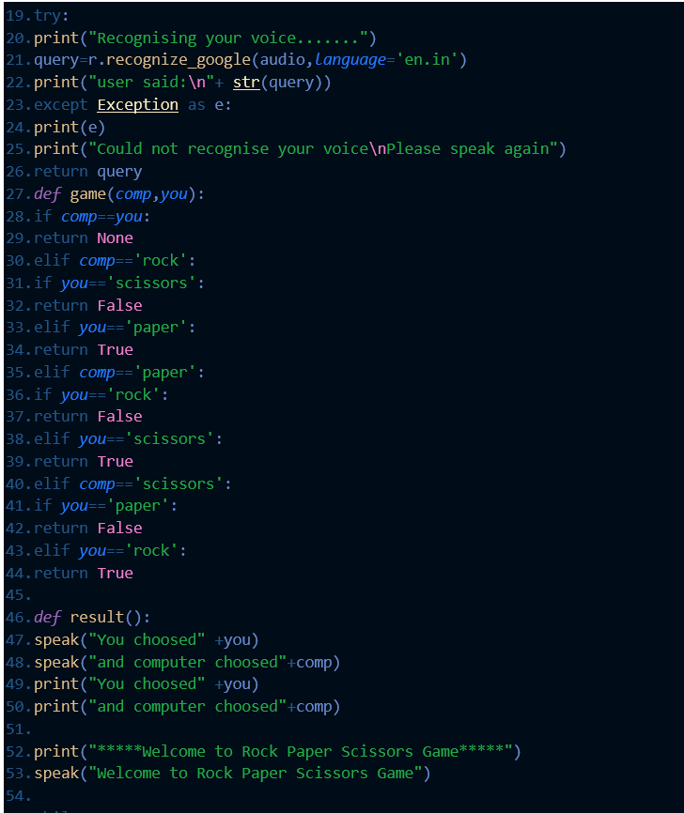
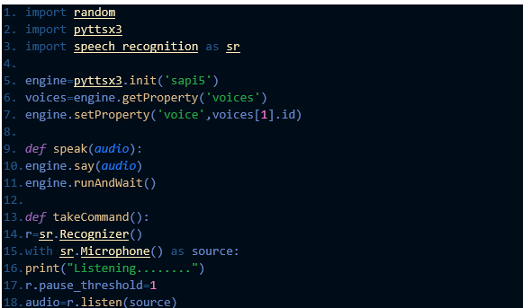
Code

Slide 5
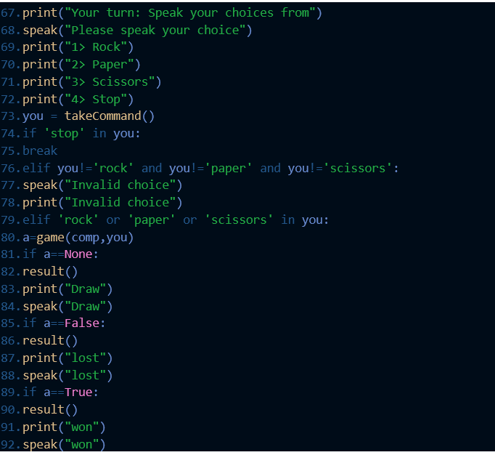
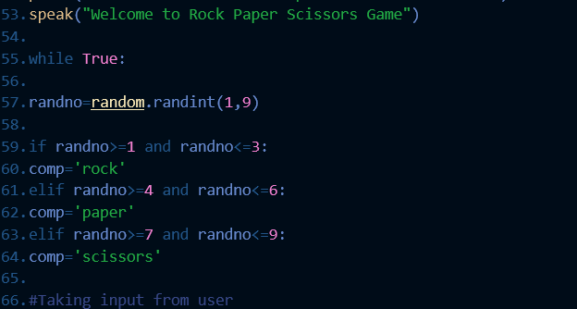

Slide 6
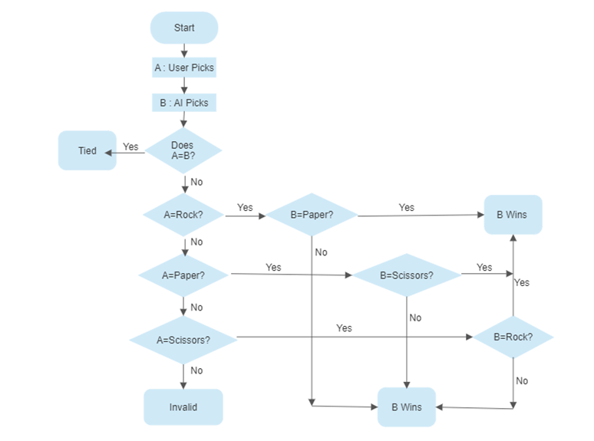
flowcart

Slide 7
Working of the program
1.Here's a simple algorithm for a rock-paper-scissors game that uses voice recognition:
->Ask the user to say "rock", "paper", or "scissors“
->Use a speech recognition library or API (such as Google Cloud Speech-to-Text) to convert the user's spoken input into text.
->Compare the user's choice to the computer's choice, which should be generated randomly.
->Determine the winner based on the standard rock-paper-scissors rules (rock beats scissors, paper beats rock, scissors beat paper).
->Display the result and ask the user if they want to play again.
->It's important to note that training a voice recognition model for Rock Paper Scissors will likely require a relatively small amount of data compared to other machine learning tasks. Therefore, even a relatively small dataset may be sufficient for this task.

Slide 8
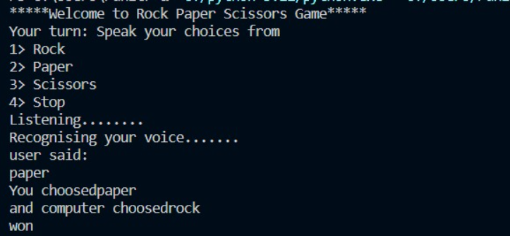
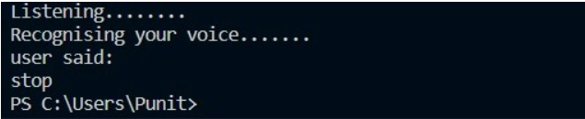

Slide 9
Applications
1. Multiplayer games: Future advancements in voice recognition technology could enable players to participate in the game,making it more social and interactive.
2. Virtual assistants: It could be integrated into virtual assistant platforms such as Alexa or Google Home.
3. Integration with other technologies:It can be other technologies such as augmented reality or virtual reality, creating an immersive gaming experience.
4. Educational applications: Voice-activated rock-paper-scissors games could be used for educational purposes such as teaching children about different hand gestures.

Slide 10
conclusion
In conclusion, voice recognition is a critical application of AI that enables machines to understand and interpret human speech.
The future scope of rock-paper-scissors voice recognition games is vast and exciting.
Advancements in voice recognition technology could make the gameplay more seamless, interactive and engaging, leading to potential applications in various fields.
As AI technology continues to improve, we can expect voice recognition to become even more advanced, accurate, and versatile, enabling machines to interact with humans in increasingly natural and intuitive ways.

